Slide 1
Hierarchical Clustering
Illustrative Example
  Agglomerative and divisive clustering on the data set {a, b, c, d ,e }
Step 0
Step 1
Step 2
Step 3
Step 4
Agglomerative
a
a b
b
Cluster distance
Termination condition
a b c d e
c
c d e
d
d e
e
Divisive
Step 4
Step 3
Step 2
Step 1
Step 0

Slide 2
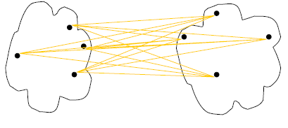
Cluster Distance Measures
Single link: smallest distance between an element in one cluster and an element in the other, i.e., d(C_{i}, C_{j}) = min{d(x_{ip}, x_{jq})}
Complete link: largest distance between an element in one cluster and an element in the other, i.e., d(C_{i}, C_{j}) = max{d(x_{ip}, x_{jq})}
Average: avg distance between elements in one cluster and elements in the other, i.e.,
d(C_{i}, C_{j}) = avg{d(x_{ip}, x_{jq})}
single link
(min)
complete link
(max)
average

Slide 3
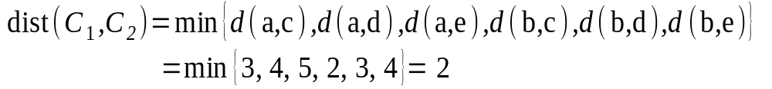
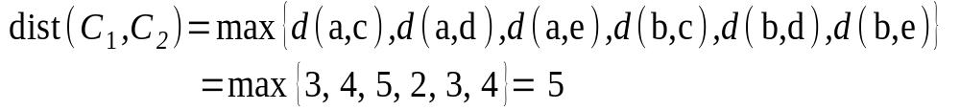
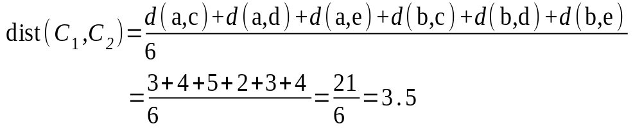
Cluster Distance Measures
  Example: Given a data set of five objects characterised by a single feature, assume that there are two clusters: C1: {a, b} and C2: {c, d, e}.
  1. Calculate the distance matrix. 2. Calculate three cluster distances between C1 and C2.
 | a | b | c | d | e
Feature | 1 | 2 | 4 | 5 | 6
Single link
Complete link
Average
 | a | b | c | d | e
a | 0 | 1 | 3 | 4 | 5
b | 1 | 0 | 2 | 3 | 4
c | 3 | 2 | 0 | 1 | 2
d | 4 | 3 | 1 | 0 | 1
e | 5 | 4 | 2 | 1 | 0

Slide 4
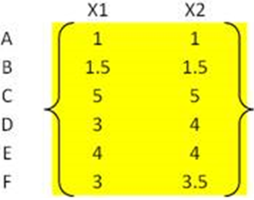
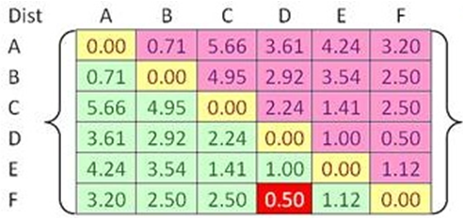


Example
Problem: clustering analysis with agglomerative algorithm
data matrix
Euclidean distance
distance matrix

Slide 5
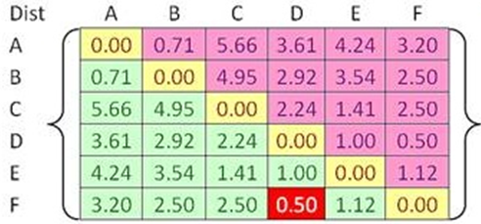
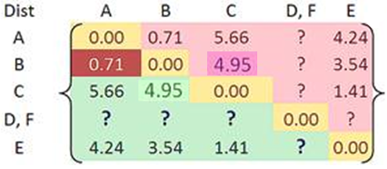

Example
Merge two closest clusters (iteration 1)

Slide 6
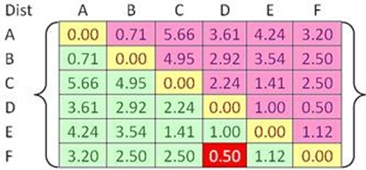

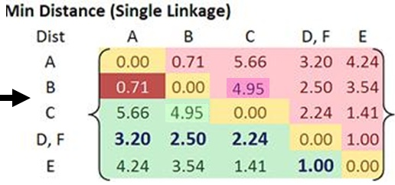
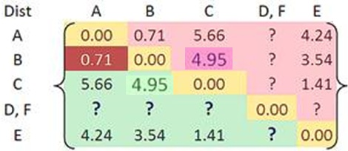
Example
Update distance matrix (iteration 1)

Slide 7
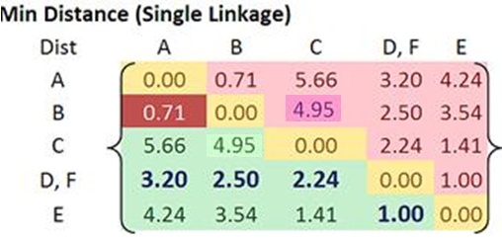
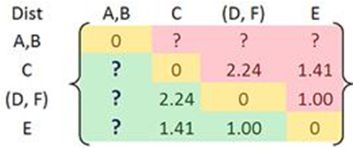
Example
Merge two closest clusters (iteration 2)

Slide 8
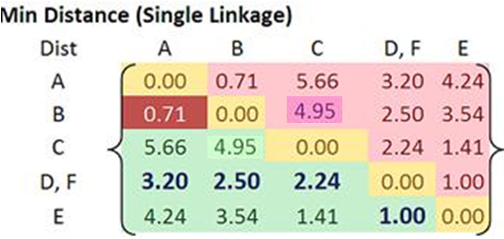
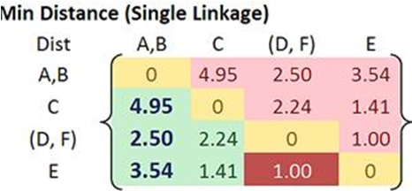

Example
Update distance matrix (iteration 2)

Slide 9
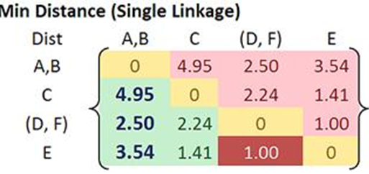
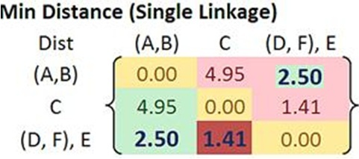

Example
Merge two closest clusters/update distance matrix (iteration 3)

Slide 10
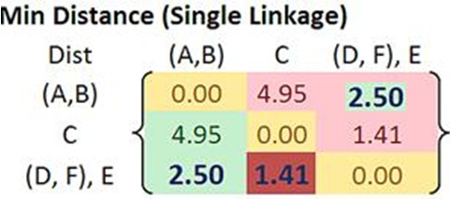
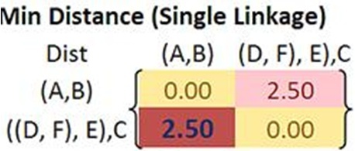

Example
Merge two closest clusters/update distance matrix (iteration 4)

Slide 11
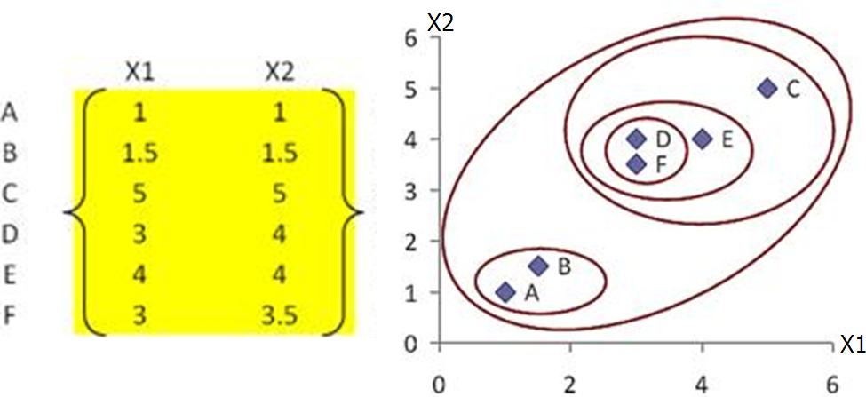
Example
Final result (meeting termination condition)

Slide 12
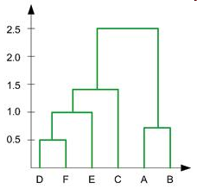
Example
Dendrogram tree representation
(numbers in dendrogram represents the step numbers)
In the beginning we have 6
clusters: A, B, C, D, E and F
We merge clusters D and F into
cluster (D, F) at distance 0.50
We merge cluster A and cluster B
into (A, B) at distance 0.71
We merge clusters E and (D, F)
into ((D, F), E) at distance 1.00
We merge clusters ((D, F), E) and C
into (((D, F), E), C) at distance 1.41
We merge clusters (((D, F), E), C)
and (A, B) into ((((D, F), E), C), (A, B))
at distance 2.50
The last cluster contain all the objects,
thus conclude the computation
6
distance
5
4
3
2
object

